Slide 1
Module-1 AWS Cloud Foundations & IAM
Introduction to Cloud Computing, Overview of AWS Global Infrastructure, AWS Shared Responsibility Model, AWS Identity and Access Management (IAM), IAM Users, Groups, and Policies, IAM Roles, IAM Best Practices

Slide 2
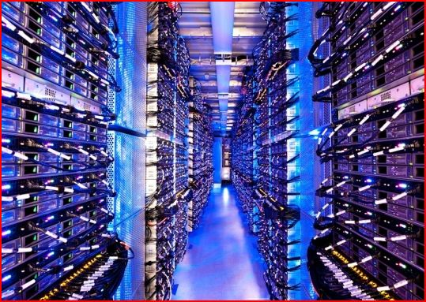

The Cloud
Historical roots in today’s Internet apps
Search, email, social networks
File storage (Live Mesh, Mobile Me, Flicker, …)
A cloud infrastructure provides a framework to manage scalable, reliable, on-demand access to applications
A cloud is the “invisible” backend to many of our mobile applications
A model of computation and data storage based on “pay as you go” access to “unlimited” remote data center capabilities
Copyright © 2012, Elsevier Inc. All rights reserved.

Slide 3
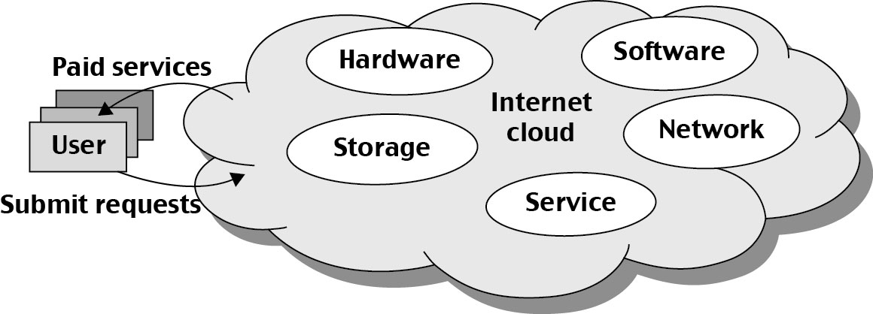
Basic Concept of Internet Clouds
Cloud computing is the use of computing resources (hardware and software) that are delivered as a service over a network (typically the Internet).
The name comes from the use of a cloud-shaped symbol as an abstraction for the complex infrastructure it contains in system diagrams.
Cloud computing entrusts remote services with a user's data, software and computation.

Slide 4
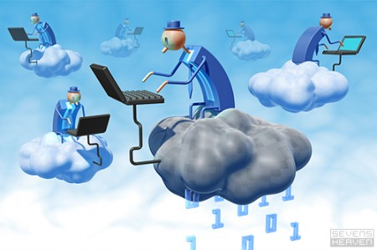
The Next Revolution in IT Cloud Computing
Classical Computing
Buy & Own
Hardware, System Software, Applications often to meet peak needs.
Install, Configure, Test, Verify, Evaluate
Manage
..
Finally, use it
$$$$....$(High CapEx)
Cloud Computing
Subscribe
Use
$ - pay for what you use, based on QoS
Every 18 months?
(Courtesy of Raj Buyya, 2012)
Copyright © 2012, Elsevier Inc. All rights reserved.

Slide 5
Cloud Service Models (1)
Infrastructure as a service (IaaS)
Most basic cloud service model
Cloud providers offer computers, as physical or more often as virtual machines, and other resources.
Virtual machines are run as guests by a hypervisor, such as Xen or KVM.
Cloud users deploy their applications by then installing operating system images on the machines as well as their application software.
Cloud providers typically bill IaaS services on a utility computing basis, that is, cost will reflect the amount of resources allocated and consumed.
Examples of IaaS include: Amazon CloudFormation (and underlying services such as Amazon EC2), Rackspace Cloud, Terremark, and Google Compute Engine.

Slide 6
Cloud Service Models (2)
Platform as a service (PaaS)
Cloud providers deliver a computing platform typically including operating system, programming language execution environment, database, and web server.
Application developers develop and run their software on a cloud platform without the cost and complexity of buying and managing the underlying hardware and software layers.
Examples of PaaS include: Amazon Elastic Beanstalk, Cloud Foundry, Heroku, Force.com, EngineYard, Mendix, Google App Engine, Microsoft Azure and OrangeScape.

Slide 7
Cloud Service Models (3)
Software as a service (SaaS)
Cloud providers install and operate application software in the cloud and cloud users access the software from cloud clients.
The pricing model for SaaS applications is typically a monthly or yearly flat fee per user, so price is scalable and adjustable if users are added or removed at any point.
Examples of SaaS include: Google Apps, innkeypos, Quickbooks Online, Limelight Video Platform, Salesforce.com, and Microsoft Office 365.

Slide 8
IT Infrastructure in Organizations
Niche Data Processing
Limited automation of core processes
Encompassing complete working

Slide 9
The Increasing IT Burden
Servers, storage
Data Centre
Security
Manpower
IT Management increasingly taking toll on core operations

Slide 10
Cloud
What
Delivery of IT / ITES(Information Technology enabled Services) similar to utility
Why
Enable organizations to focus on core businesses
How
Use of online services; You are on cloud
Making IT possible in background
No up-front costs : CAPEX-Capital expenditure

Slide 11
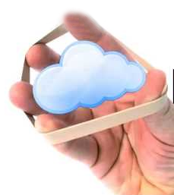
Characteristics
Elasticity
Computational capacity increases and decreases automatically vis-à-vis the instantaneous computational requirements

Slide 12

Characteristics
Tariff for metered usage
Only for the resources allocated & utilized –
exclusively for your time of usage

Slide 13
Characteristics
Multi-tenancy
Single instance serves heterogeneous user requirements
Instance (Service)
User - 1
User - 2
User - n

Slide 14
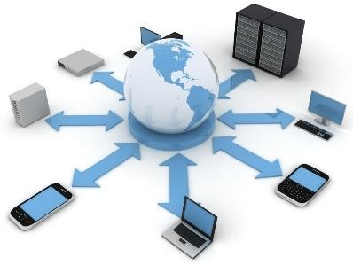

Characteristics
Business continuity with
ubiquitous access

Slide 15
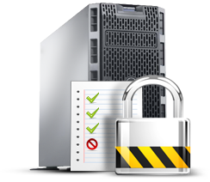
Characteristics
Security
Every user services are completely isolated from each other

Slide 16

Characteristics
Optimal resource utilization
Harnessing underutilized capacity

Slide 17
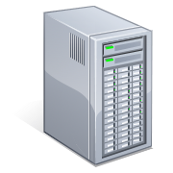

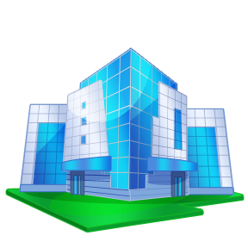
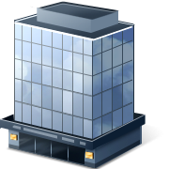

Classical (Data Centre) Approach
APP
Data
APP
Data
APP
Data

Slide 18
Cloud Centre
App
Data
App
Data
App
Data
Virtualization

Slide 19
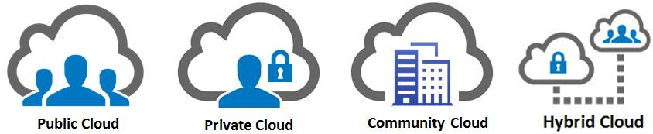
Cloud – Functional Taxonomy
IaaS
PaaS
SaaS
DaaS
BPaaS
XaaS

Slide 20
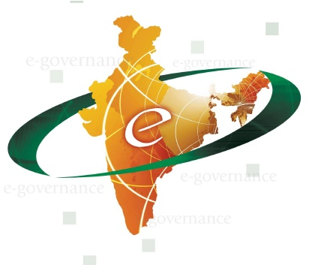
Cloud for e-Governance
Sustainable media for Digital India to deliver citizen-centric services
Ease of Scaling benefiting sector
Timely delivery of welfare measures to the desired target- efficacy & efficiency

Slide 21
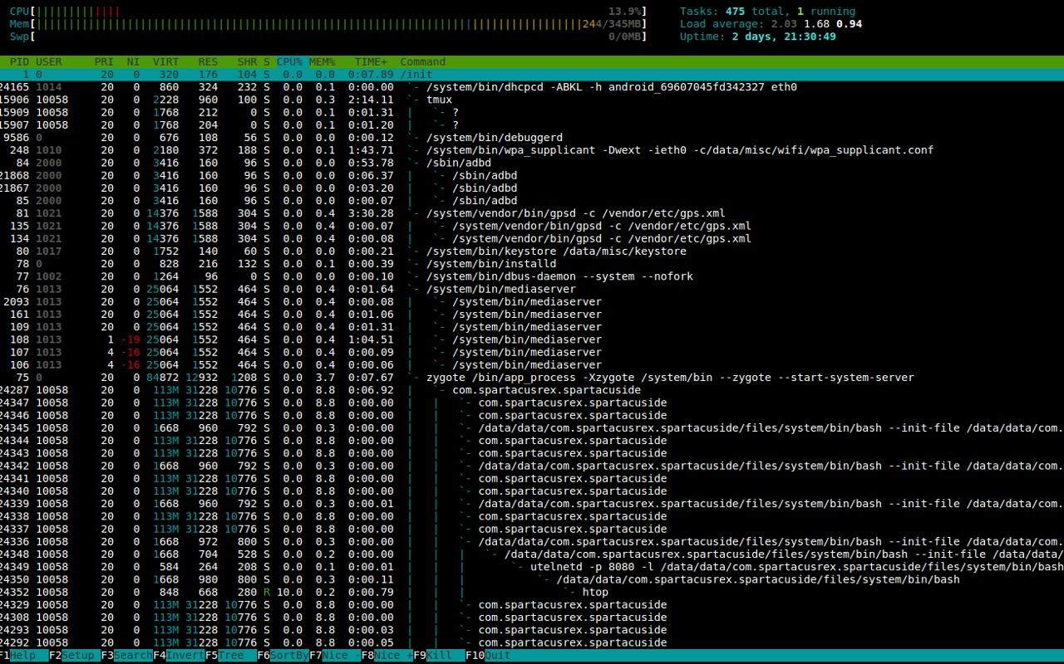

Revisit to OSS Paradigm
Higher degree of customization
Extensible
Redistribution
Open standards - interoperability, flexibility
No Vendor Lock-in

Slide 22

“Reliable Alternative" to commercial counterparts
Vibrant communities manifesting as support system.
Aggressive user driven release cycles
Access to the code base and APIs’

Slide 23
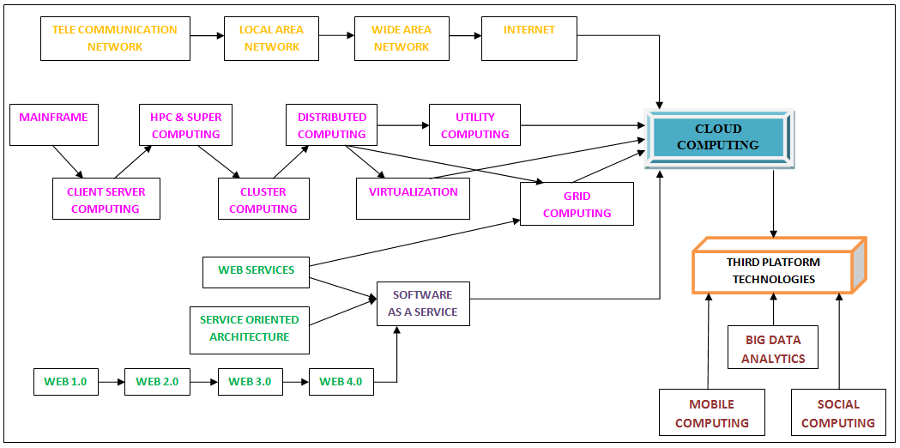
Evolution of Cloud

Slide 24
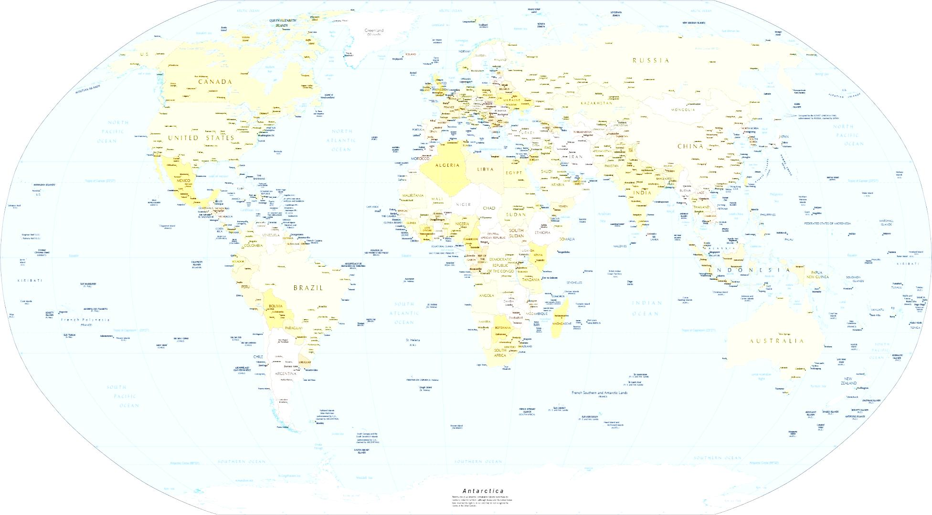
Cloud in e-Governance - Survey of contemporary practice
Meghraj - GI Cloud : India
G-Cloud : U.K.
Cloud First Initiative : U.S.
Cloud Services Panel : Australia
G-Cloud : Singapore

Slide 25
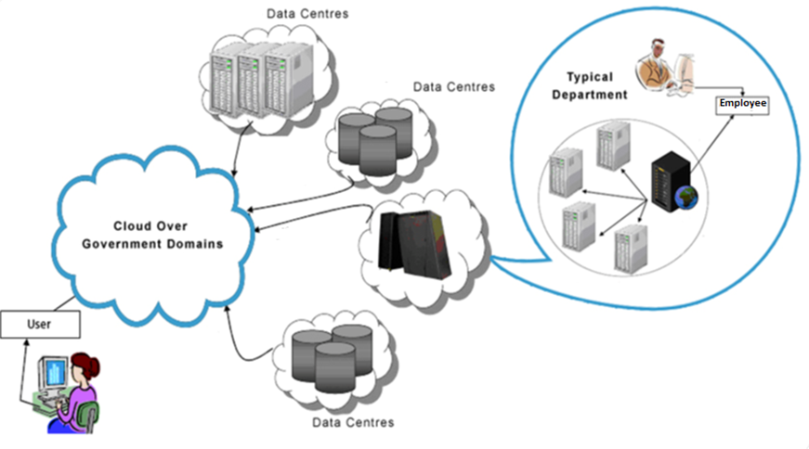
Cloud scenario

Slide 26
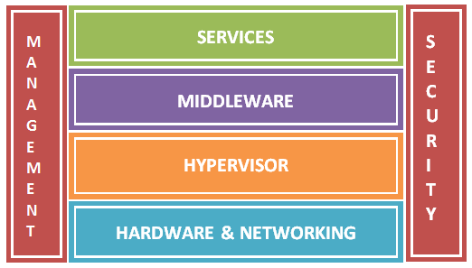
Cloud Layers – Architectural View

Slide 27
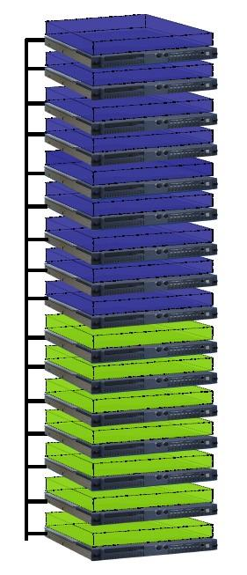
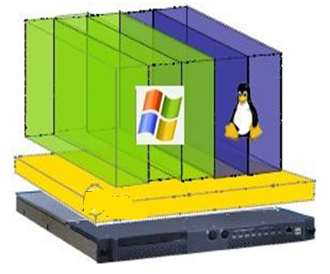
Physical Hardware vs.
Virtual Hardware

Slide 28
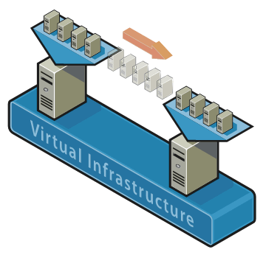
Virtualization
Server
Processor
Memory
Storage
Network
Software
Application
Data

Slide 29
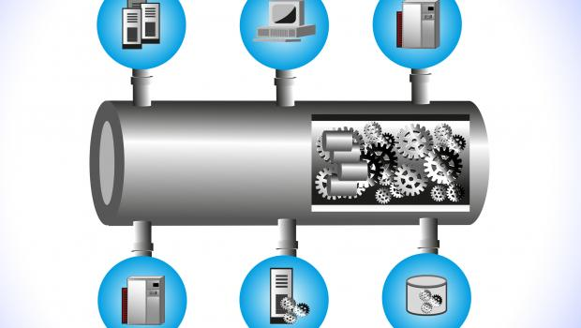
Middleware
Core cloud component - Brain
Functionalities
Orchestrating
Scheduling
Coordinating resources
Compute; Storage & Network
Provisioning user request

Slide 30
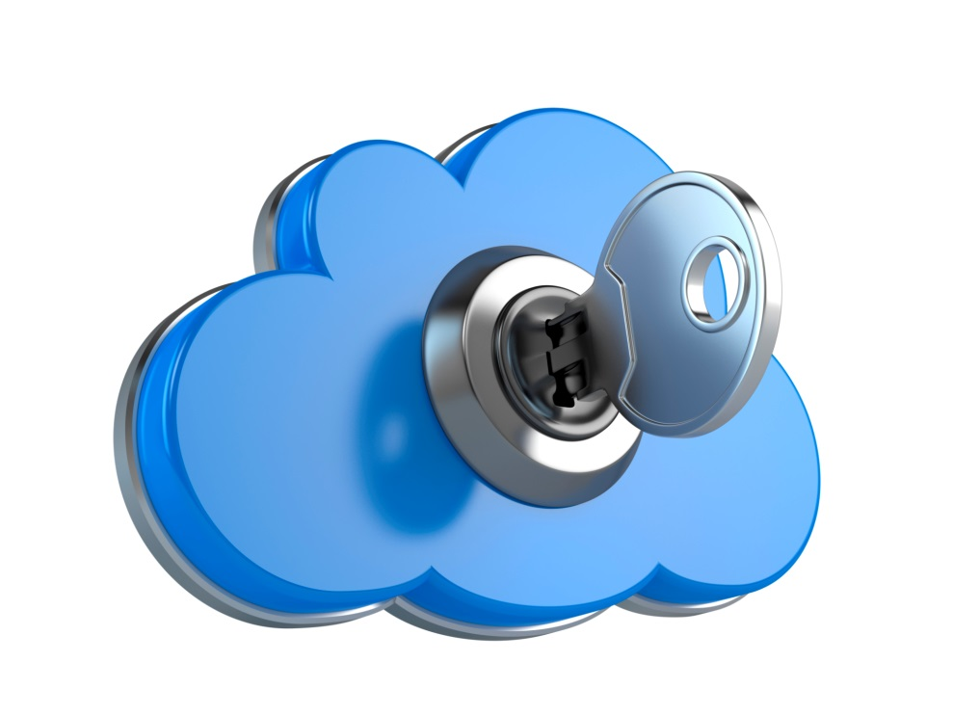
Security
Physical
Network
Infrastructure
Operating system
Virtualization
Virtual machines
Application
Data

Slide 31

Management
Monitoring
Metering
SLA Compliance
Backup and Disaster recovery
Business process

Slide 32
Bricks and mortar of a Cloud
Data centre
Server
Storage
Network
Hypervisor
Middleware
Software stack
Management components
Technical / IT
Non Technical / Non - IT
Application, Database
Security
Business units

Slide 33
AWS Global Infrastructure
The AWS Global Infrastructure is designed and built to deliver a flexible, reliable, scalable, and secure cloud computing environment with high-quality global network performance.
AWS continually updates its global infrastructure footprint. Visit one of the following web pages for current infrastructure information:

Slide 34
AWS Global Infrastructure Map:
https://aws.amazon.com/about-aws/global-
infrastructure/#AWS_Global_Infrastructure_Map
Choose a circle on the map to view summary information about the Region represented by the circle.
• Regions and Availability Zones:
https://aws.amazon.com/about-aws/global-
infrastructure/regions_az/
Choose a tab to view a map of the selected geography and a list of Regions, Edge locations, Local zones, and Regional
Caches.

Slide 35
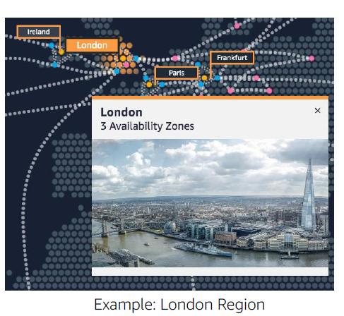
AWS Regions
An AWS Region is a geographical area.
• Data replication across Regions is
controlled by you.
• Communication between Regions uses
AWS backbone network infrastructure.
• Each Region provides full redundancy and
connectivity to the network.
• A Region typically consists of two or more
Availability Zones.

Slide 36
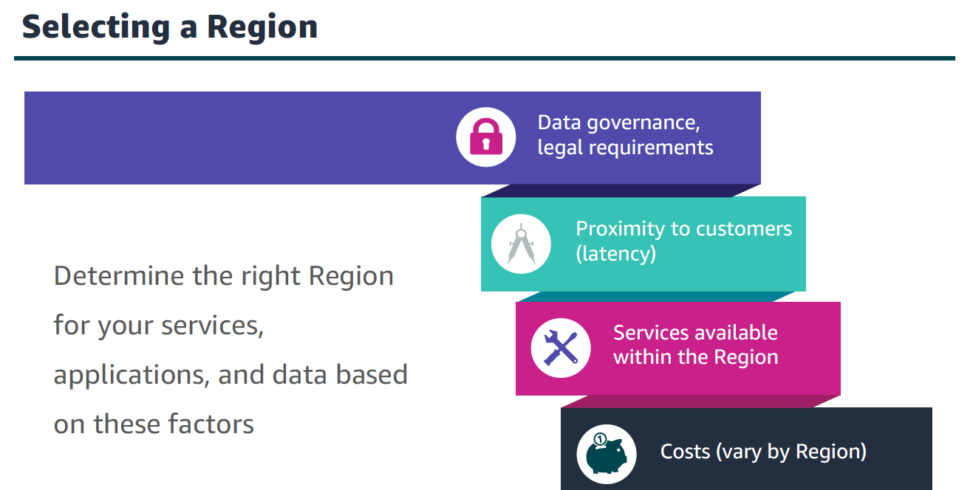

Slide 37
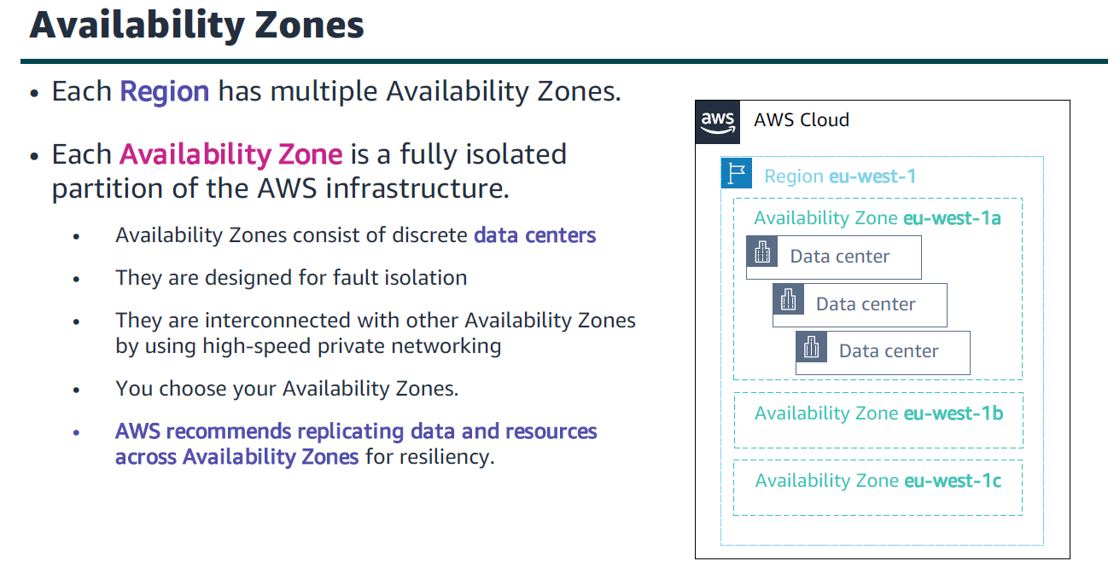

Slide 38
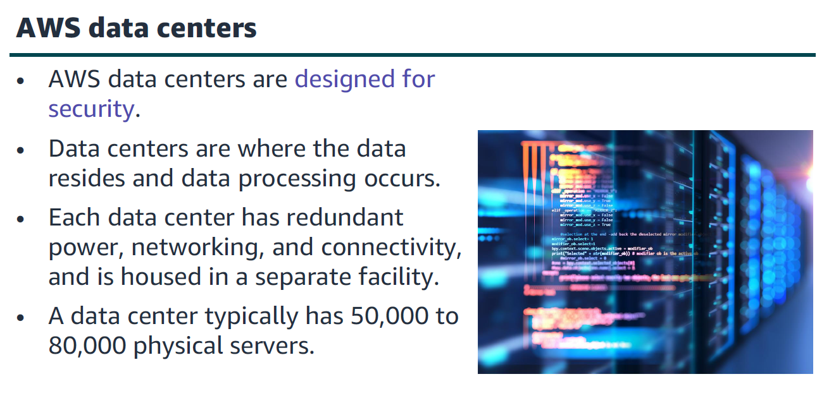

Slide 39
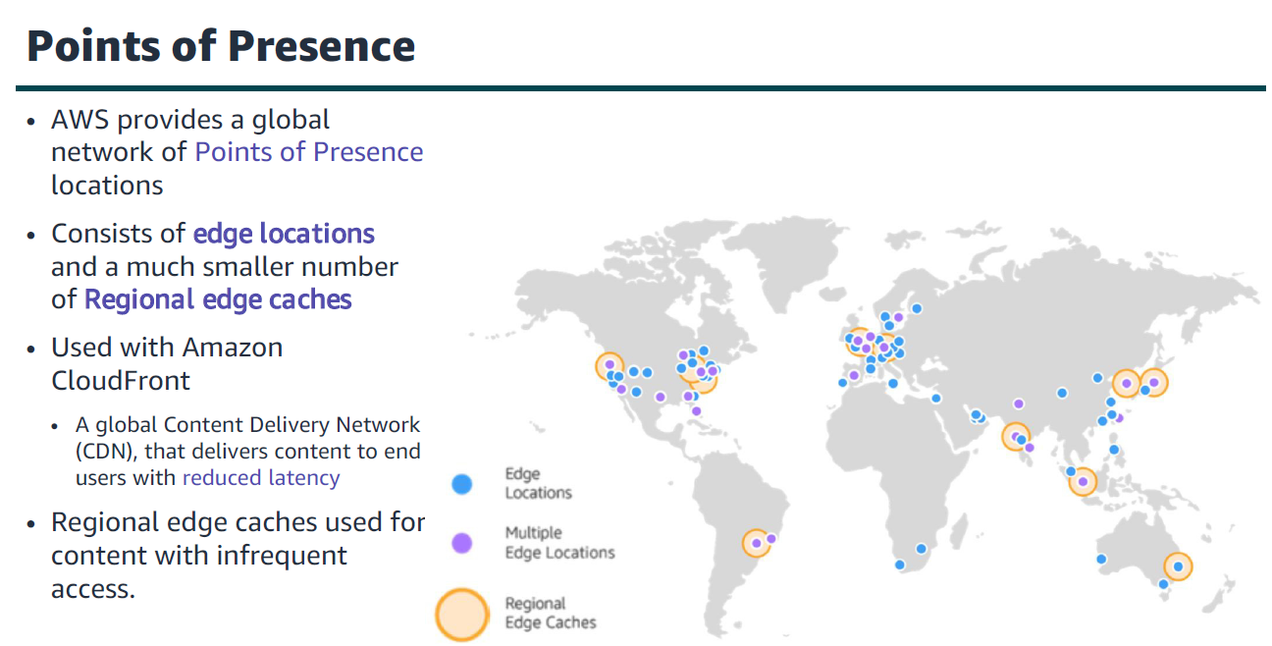

Slide 40
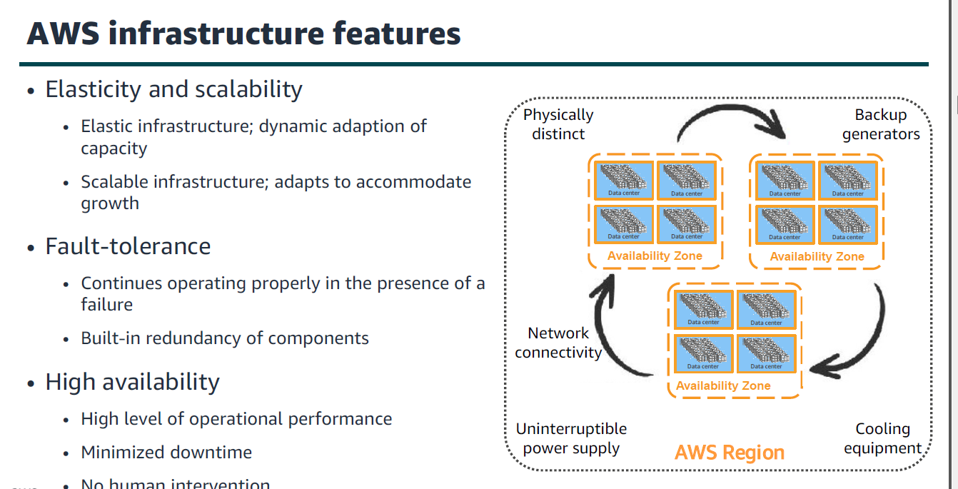

Slide 41
The AWS Global Infrastructure consists of
Regions and Availability Zones.
• Your choice of a Region is typically based on
compliance requirements or to reduce latency.
• Each Availability Zone is physically separate from
other Availability Zones and has redundant
power, networking, and connectivity.
• Edge locations, and Regional edge caches
improve performance by caching content closer
to users.

Slide 42
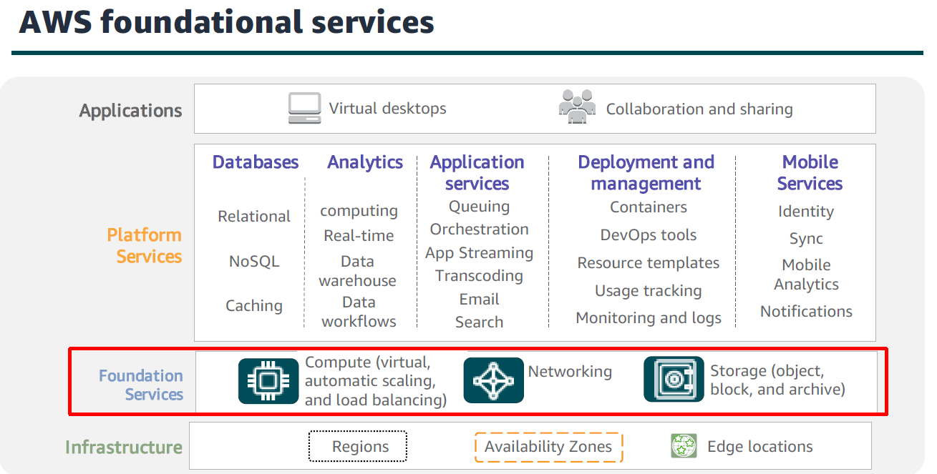
AWS services and service category overview

Slide 43
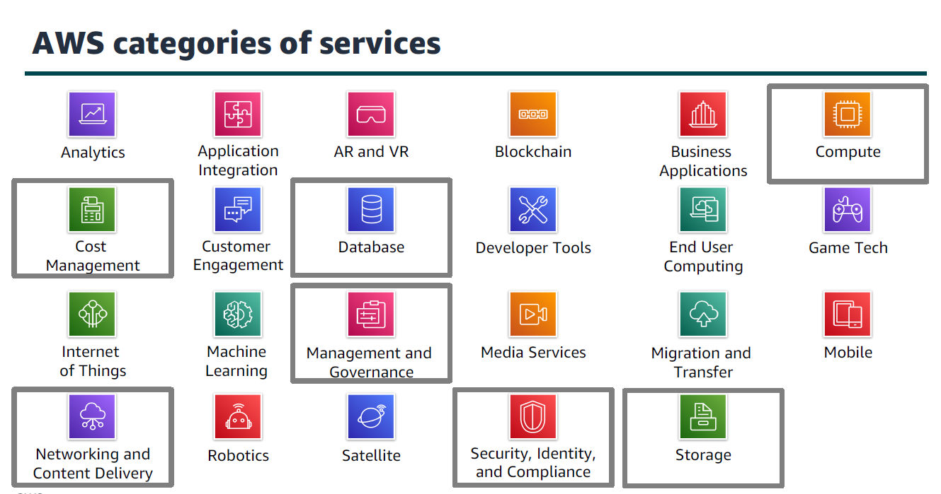

Slide 44
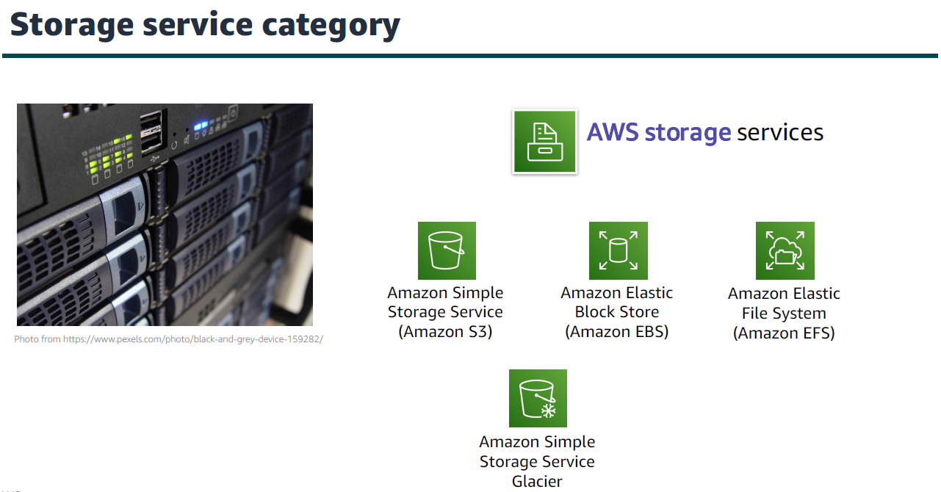

Slide 45
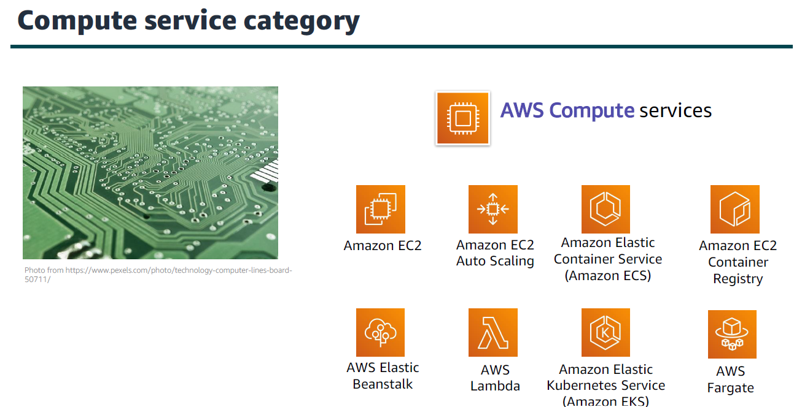

Slide 46
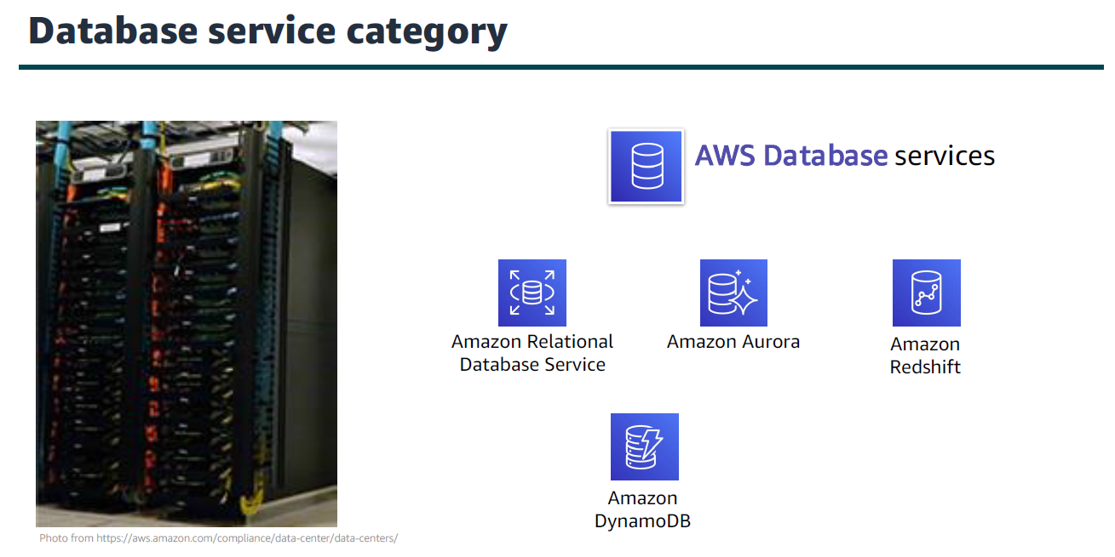

Slide 47
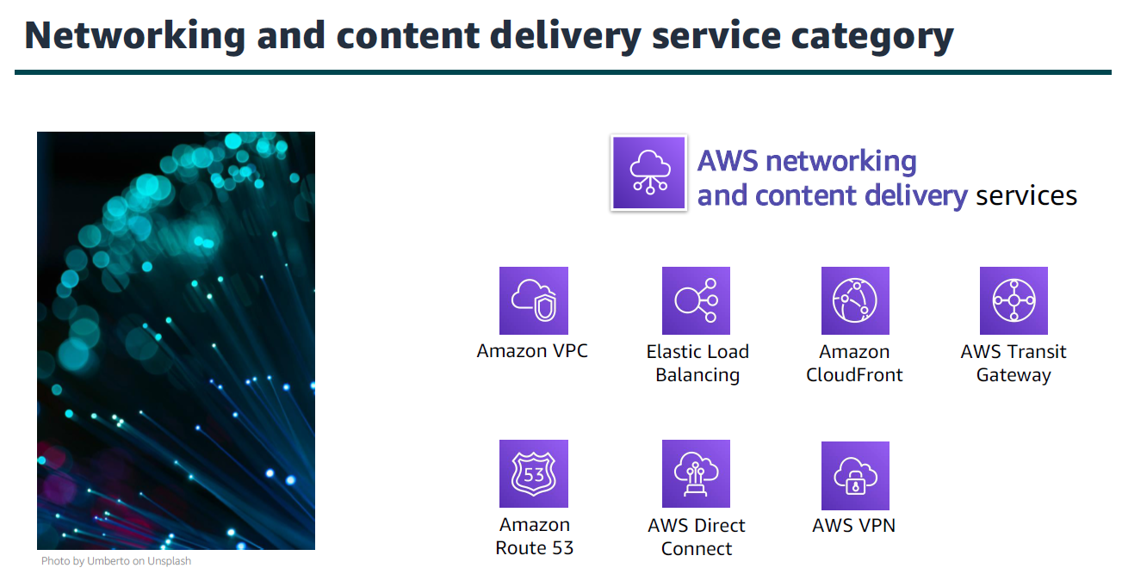

Slide 48
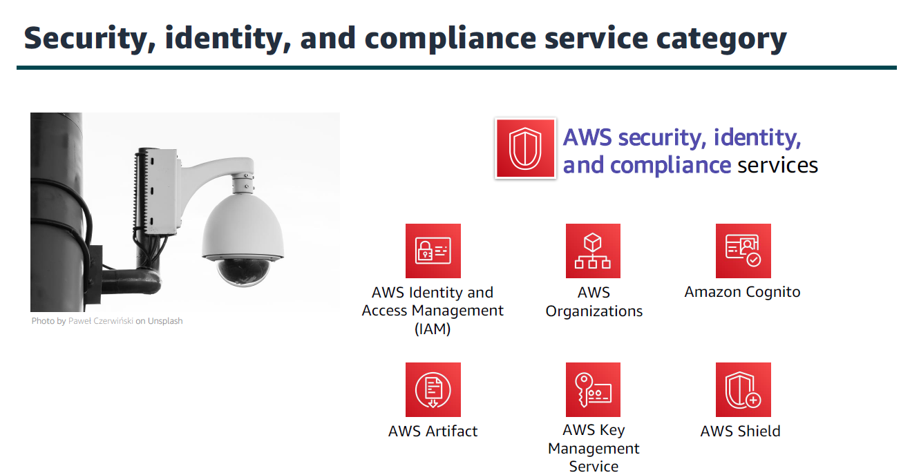

Slide 49
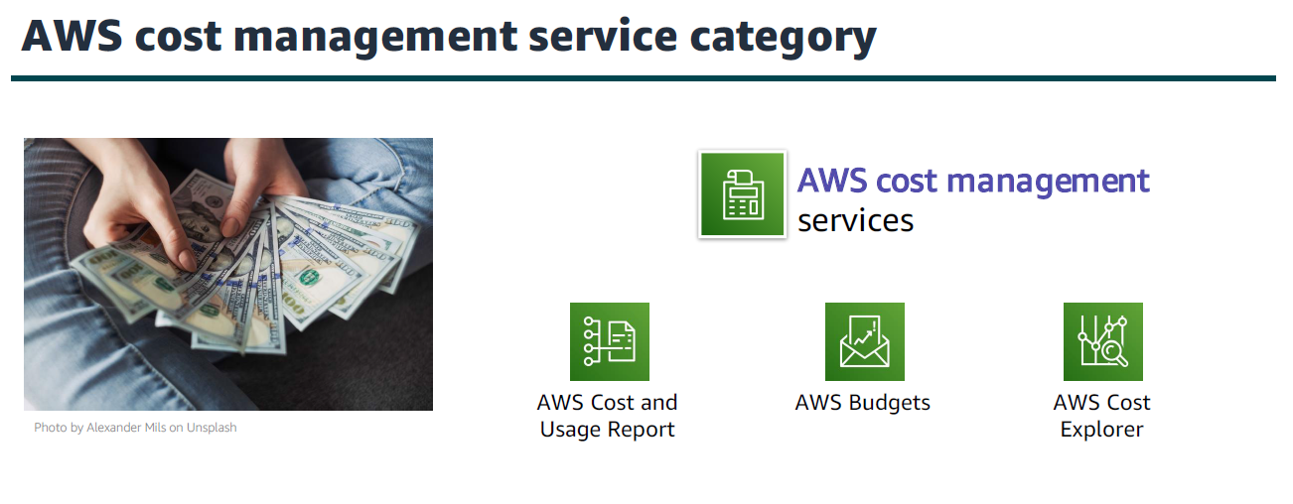

Slide 50
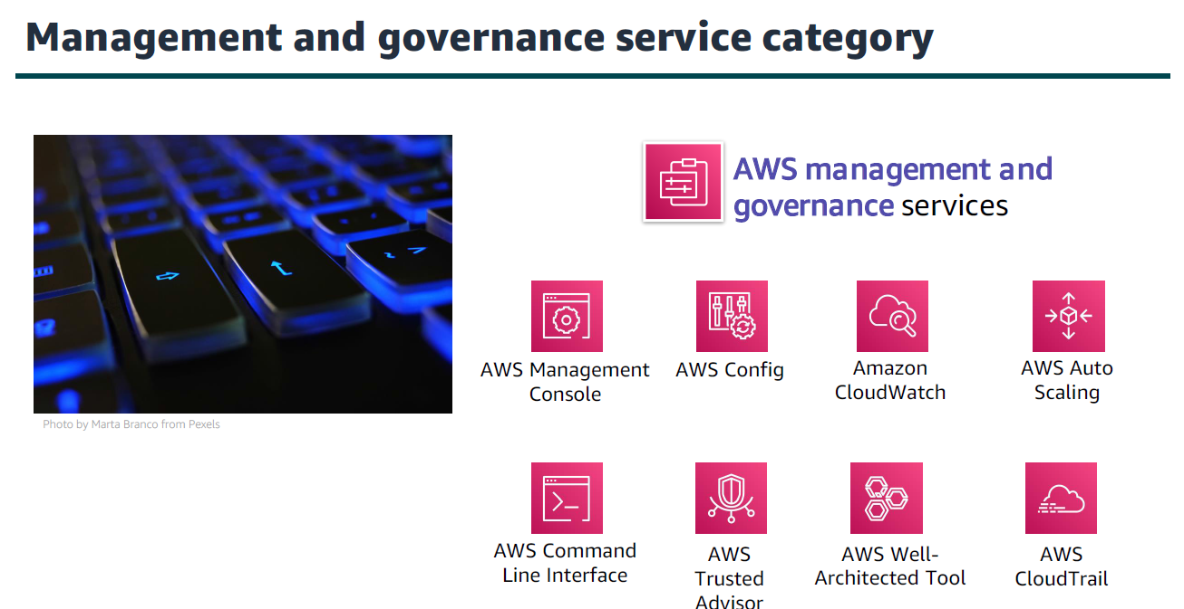

Slide 51
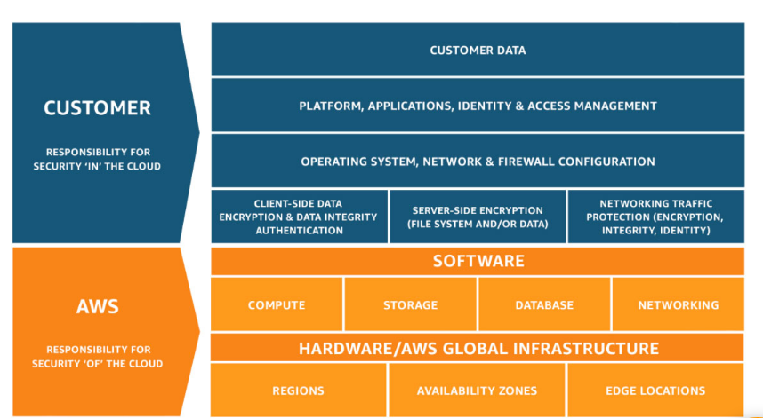
AWS Shared Responsibility Model

Slide 52
AWS secures the infrastructure, while customers are responsible for securing their data and applications within the cloud.

Slide 53
Security and Compliance is a shared responsibility between AWS and the customer.
This shared model can help relieve the customer’s operational burden as AWS operates, manages and controls the components from the host operating system and virtualization layer down to the physical security of the facilities in which the service operates.
The customer assumes responsibility and management of the guest operating system (including updates and security patches), other associated application software as well as the configuration of the AWS provided security group firewall.

Slide 54
AWS responsibility “Security of the Cloud” - AWS is responsible for protecting the infrastructure that runs all of the services offered in the AWS Cloud. This infrastructure is composed of the hardware, software, networking, and facilities that run AWS Cloud services.

Slide 55
Customer responsibility “Security in the Cloud” – Customer responsibility will be determined by the AWS Cloud services that a customer selects. This determines the amount of configuration work the customer must perform as part of their security responsibilities.

Slide 56
Inherited Controls- Controls which a customer fully inherits from AWS.
Ex. If you deploy an application on AWS, you do not need to worry about the physical security of the servers because AWS already provides and manages those protections.
Shared Controls-Controls which apply to both the infrastructure layer and customer layers.
Ex. AWS provides IAM service; customers define and enforce policies and permissions.
Customer Specific – Controls which are solely the responsibility of the customer based on the application they are deploying within AWS services.

Slide 57
Customer Specific
Application-level security (e.g., input validation, secure coding)
Encryption of data within your app
User access and authentication mechanisms for your custom application
Backup and data recovery plans for your deployed apps

Slide 58
AWS Identity and Access Management (IAM)
Use IAM to manage access to AWS resources –
A resource is an entity in an AWS account that you can work with
Example resources; An Amazon EC2 instance or an Amazon S3 bucket.
Example – Control who can terminate Amazon EC2 instances

Slide 59
Create and manage AWS users and groups: Define who can access resources and what permissions they have.
Set permissions: Grant specific privileges to users, groups, and roles using policies.
Multi-factor authentication (MFA): Add an extra layer of security by requiring MFA for sensitive operations.
Role-based access control: Assign roles to users or services for temporary access to resources.

Slide 60
Define fine-grained access rights –
Who can access the resource
Which resources can be accessed and what can the user do to the resource
How resources can be accessed

Slide 61
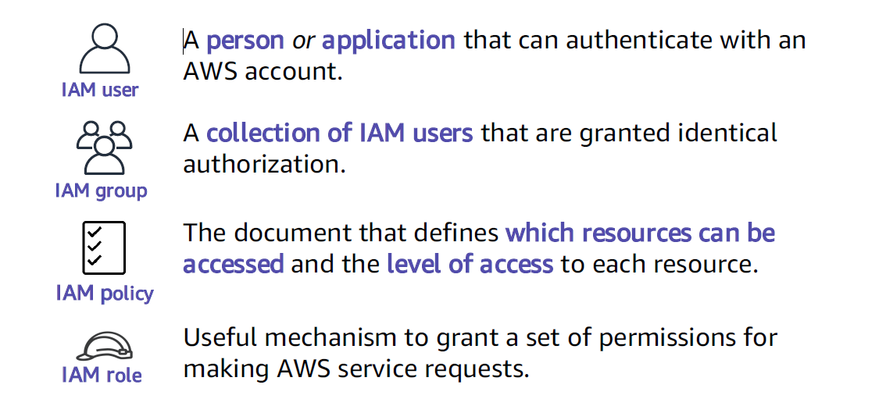
IAM: Essential components

Slide 62
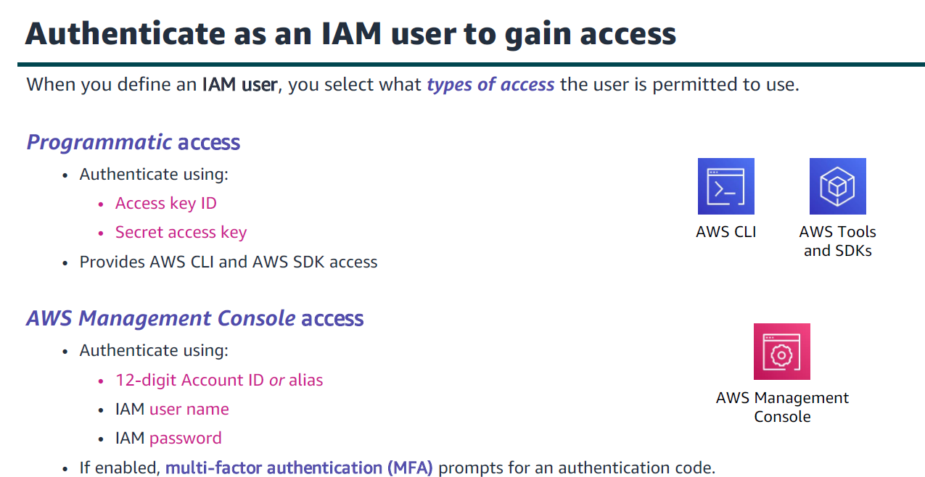

Slide 63
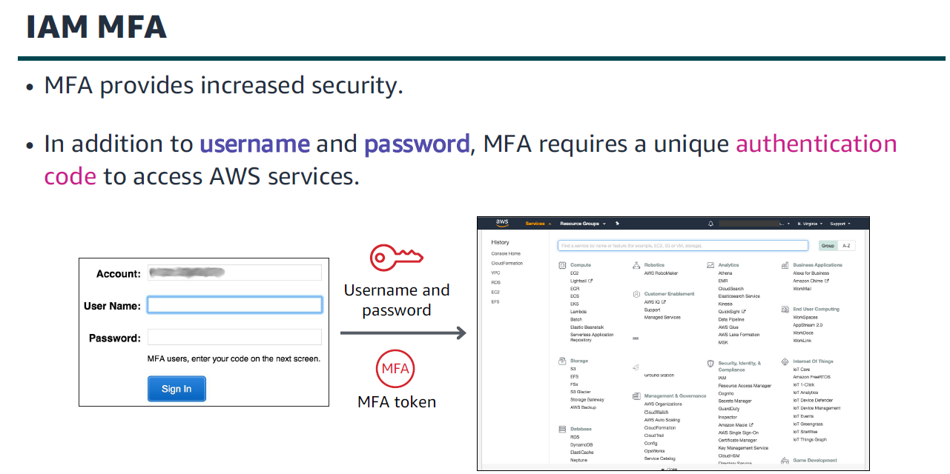

Slide 64
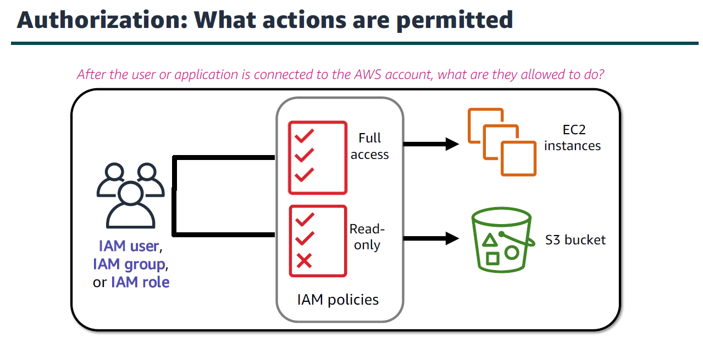

Slide 65
IAM: Authorization
Assign permissions by creating an IAM policy.
• Permissions determine which resources and operations are allowed:
• All permissions are implicitly denied by default.
• If something is explicitly denied, it is never allowed.
Best practice: Follow the principle of least privilege.
Note: The scope of IAM service configurations is global. Settings apply across all AWS Regions

Slide 66
IAM policies
An IAM policy is a document that defines permissions
Two types of policies – identity-based and resource-based
• Identity-based policies –
• Attach a policy to any IAM entity
• An IAM user, an IAM group, or an IAM role
• Policies specify:
• Actions that may be performed by the entity
• Actions that may not be performed by the entity
• A single policy can be attached to multiple entities
• A single entity can have multiple policies attached to it
• Resource-based policies
• Attached to a resource (such as an S3 bucket)

Slide 67
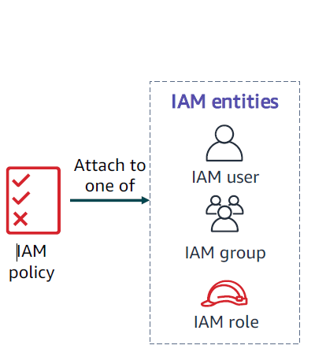

Slide 68
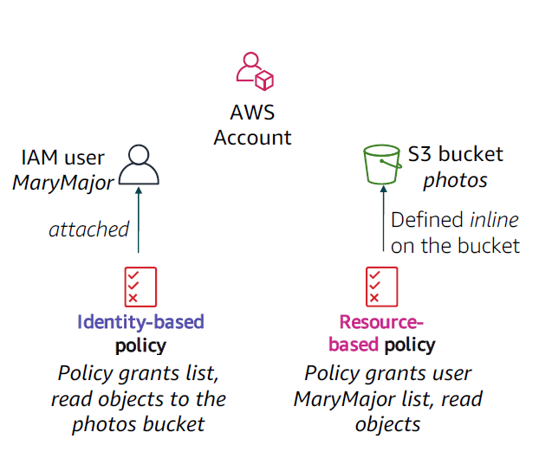

Slide 69
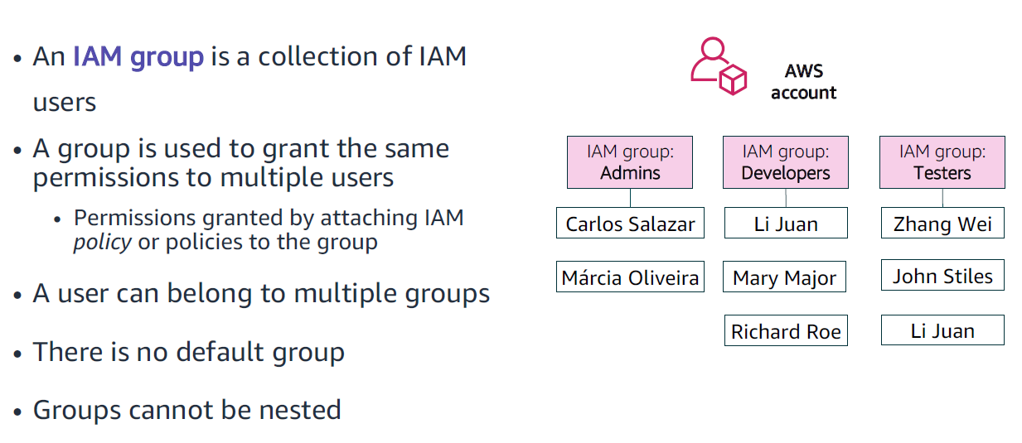

Slide 70
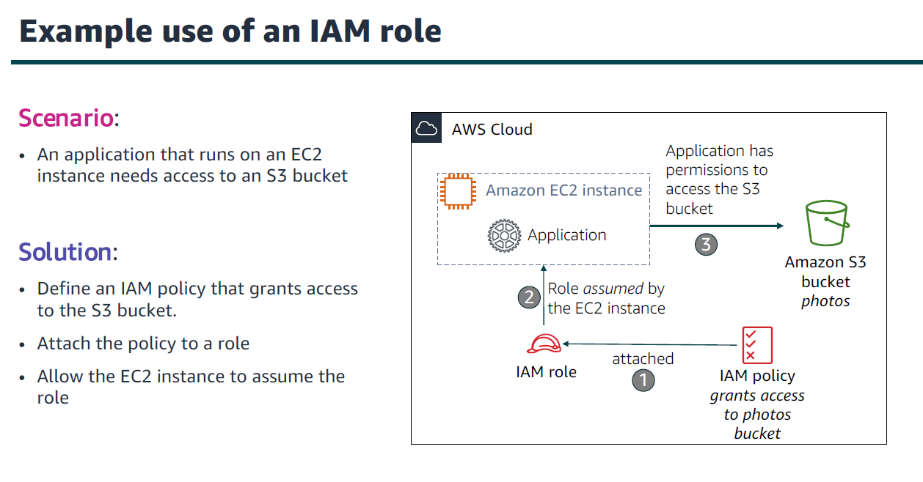

Slide 71
Security best practices in IAM
Require human users to use federation with an identity provider to access AWS using temporary credentials
Require workloads to use temporary credentials with IAM roles to access AWS
Require multi-factor authentication (MFA)
Update access keys when needed for use cases that require long-term credentials
Follow best practices to protect your root user credentials
Apply least-privilege permissions
Get started with AWS managed policies and move toward least-privilege permissions
Use IAM Access Analyzer to generate least-privilege policies based on access activity
Regularly review and remove unused users, roles, permissions, policies, and credentials
Use conditions in IAM policies to further restrict access
Verify public and cross-account access to resources with IAM Access Analyzer
Use IAM Access Analyzer to validate your IAM policies to ensure secure and functional permissions
Establish permissions guardrails across multiple accounts
Use permissions boundaries to delegate permissions management within an account

